Slide 1
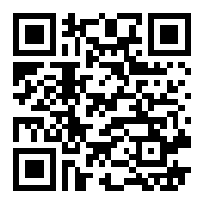
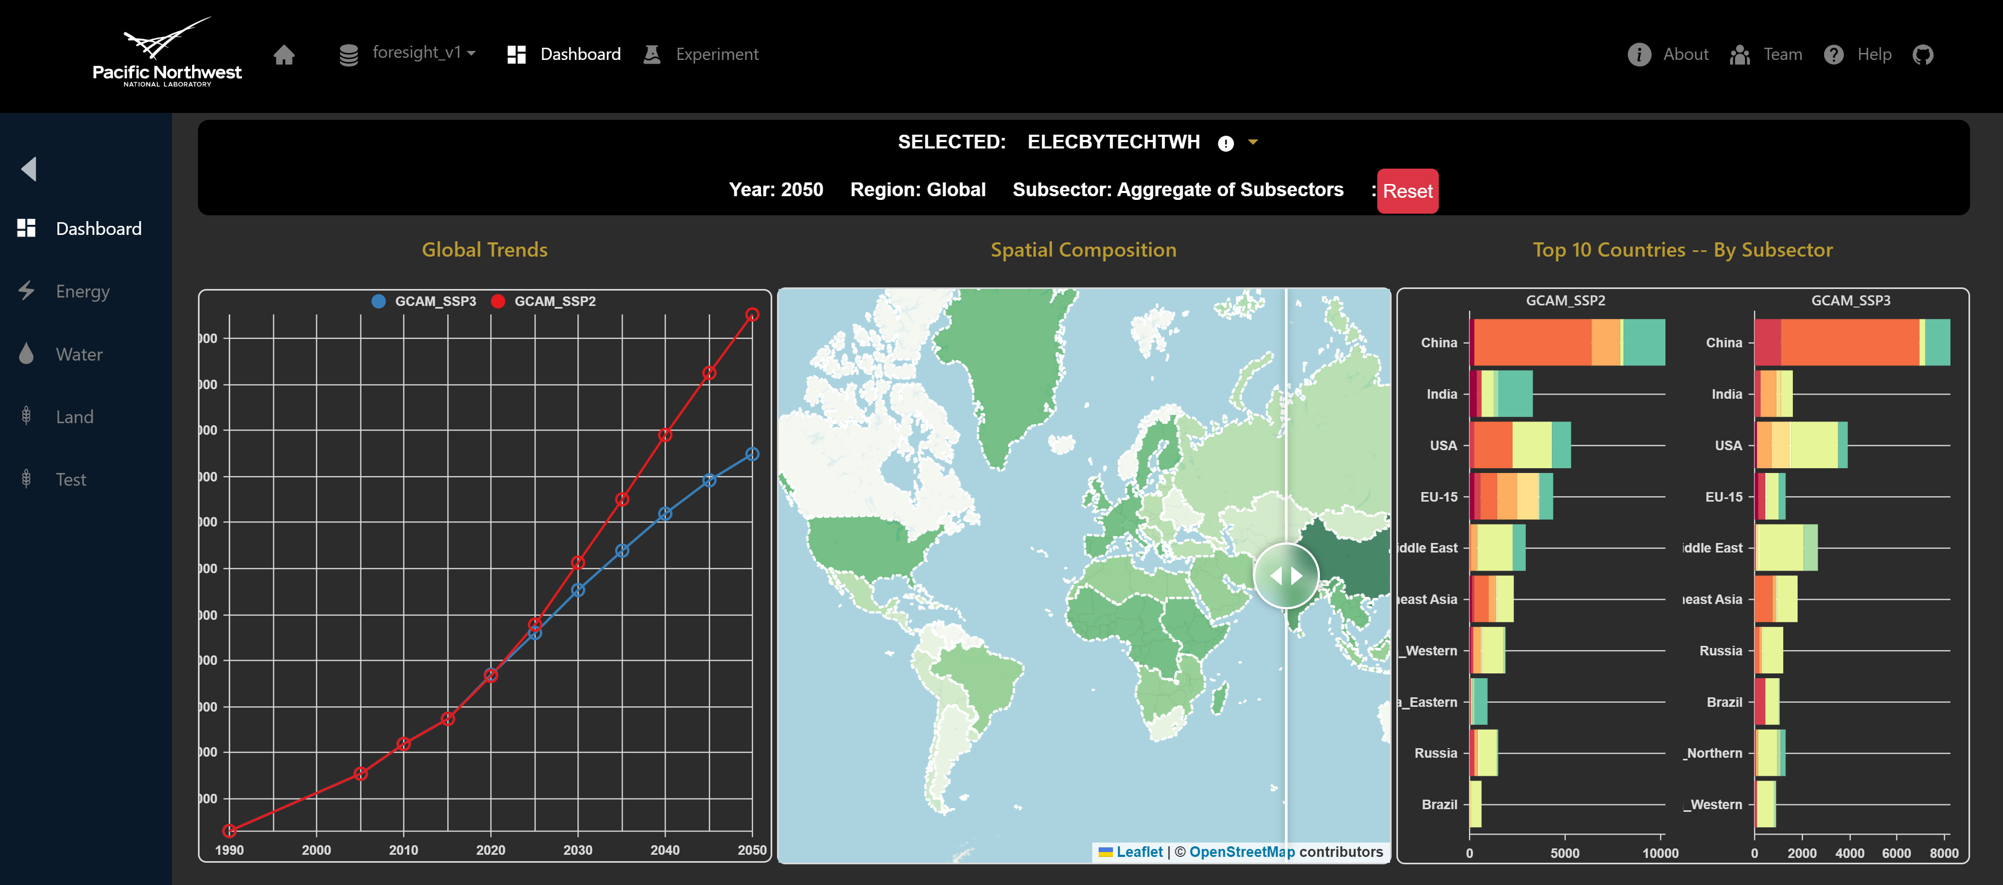
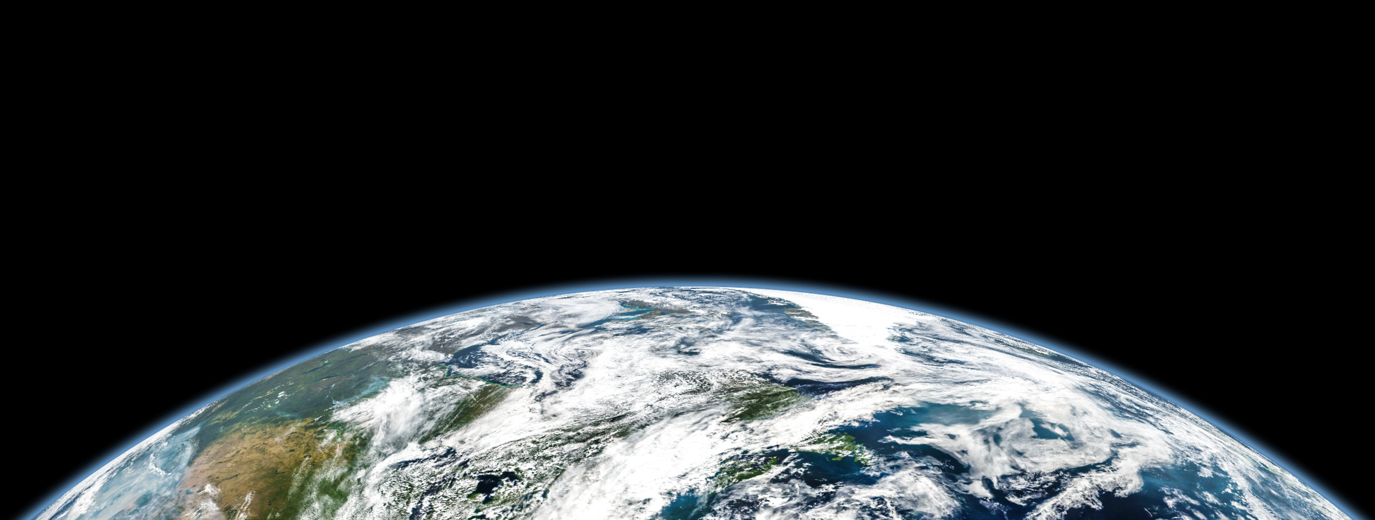








Foresight – Global change analytics for communicating complex science
Zarrar Khan*, Benjamin Knight, Mengqi Zhao, Taryn Waite, Hassan Niazi, Chris Vernon
*zarrar.khan@pnnl.gov
Design Philosophy
Single Point of Access
Community
Visual Excellence
AI-Driven Insights
Access analysis-specific highlights as well as broader insights across water, energy, land, and many other systems, leveraging the power of our integrated suite of tools.
All figures shareable across platforms, inviting feedback and comments from the community to drive continuous improvement.
We strive to make each figure stand out as the best in class, featuring interactive, minimalistic, and powerful designs customized to convey each insight most effectively
Leverage AI-driven interactions to "talk" to our datasets and extract personalized insights and customized graphics.
Scalable
Interactive
Layers
Responsive
Scalable AWS backend
Cross-filters
Click, scroll, slide
Customize
Nested layers and insights
Any device, any screen
Data linked across charts
Save & share customized selections
11/9/2023
| PNNL-SA-XXXXX

